Slide 1
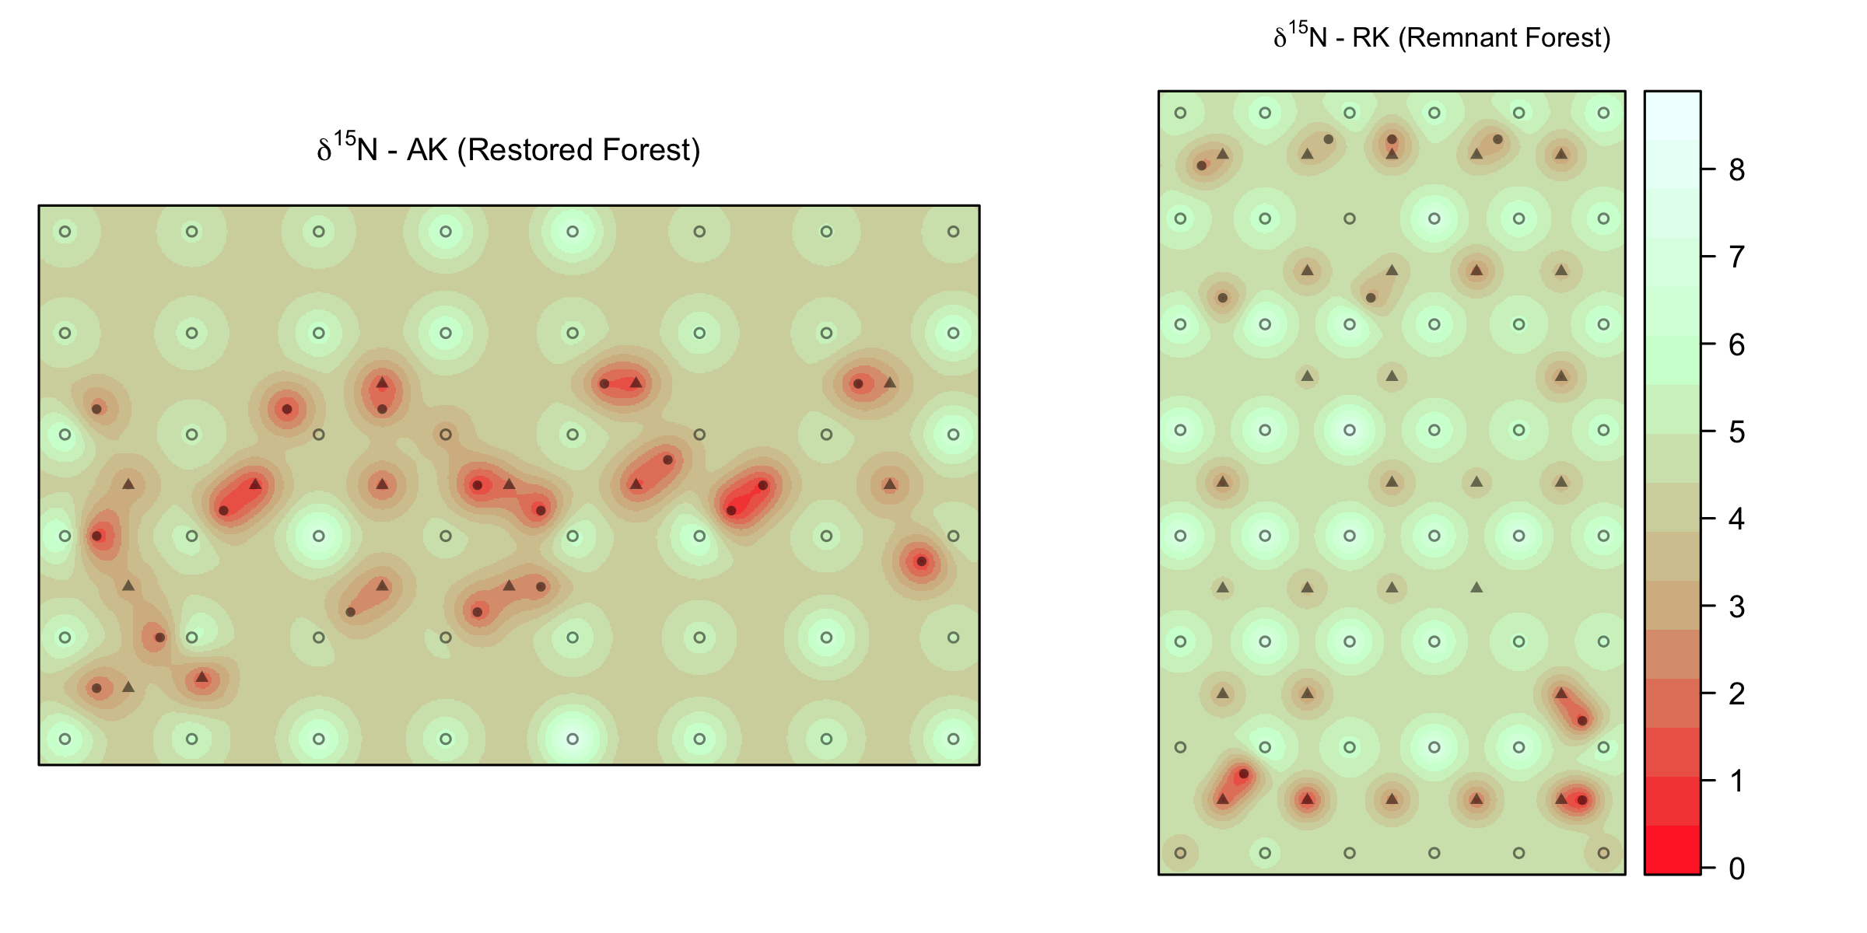
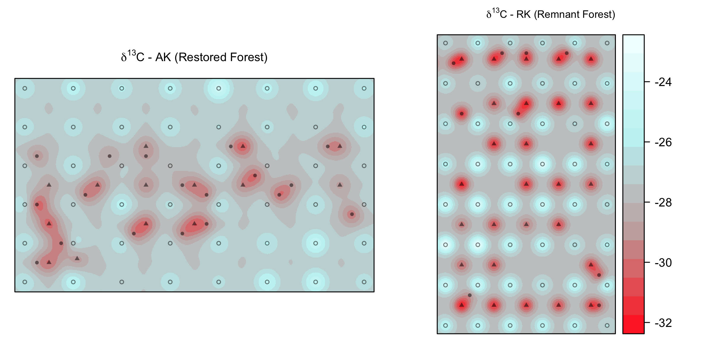
A
Nitrogen isoscape
C
Carbon isoscape
Koa Plantation (KP)
B
D
Remnant Forest (RK)
δ¹³C ‰
δ¹⁵N ‰
5 m
soil samples
A. koa
Rubus spp.
N

